Slide 1


CS 6831 Designing Secure Cryptography
Tom Ristenpart

Slide 2
Instantiate Hash-based PRF with SHA-256
K
M1
M2||10^{r} || <|M|>
K || M
H
Y
f
f
f
IV
Y
All MD-based hashes vulnerable to length-extension attacks!

Slide 3

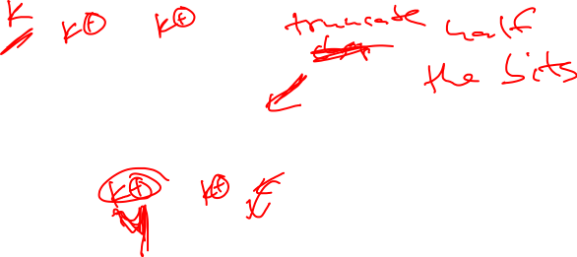
Client authentication on web
[Solo, Kent] [Tsudik – ’92]
PW
PW
msg, H^{f}( PW ∥ msg )
User sent
msg
User
msg ∥ L ∥ X,
H^{f}( PW ∥ msg ∥ L ∥ X )
User sent
msg ∥ L ∥ X
RFC 2069 (HTTP Digest Authentication)
PW
msg
L = 2d
f
f
f
IV
H^{f}(PW ∥ msg)
= h
Extension
attack
X
4d
f
f
h
H^{f}(PW ∥ msg ∥ L ∥ X)

Slide 4
Two ways to fix
Figure out other constructions for hash-based PRFs using current hash functions
But: extension (or other) attacks that abuse MD-structure may arise elsewhere
Can we build hash functions that better emulate a RO?

Slide 5
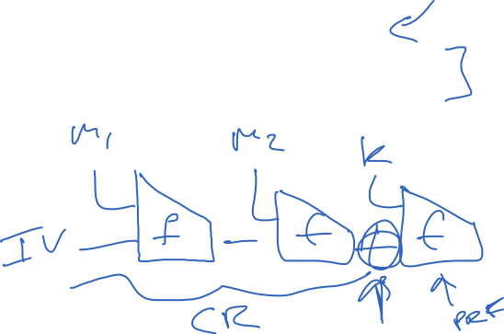
Other ways to build hash-based PRFs
Suffix MAC: H^{f}(M || K)
Envelope MAC: H^{f}(K1 || M || K2)
Nested MAC: H^{f}(K1 || H^{f}( K2 || M ) )

Slide 6
Building PRFs with hash functions: HMAC
Use a hash function H to build a MAC. K is a secret key
If |K| > d then K <- H(K). Pad K with zeros to d bits
ipad != opad are constants
K ipad || M
H
K opad || h
H
Y
HMAC-SHA-1, HMAC-SHA-256, etc.
Can show security holds assuming either that:
H is random oracle
Compression function f underlying H is PRF even under related-key attacks when suitable inputs are taken as keys

Slide 7
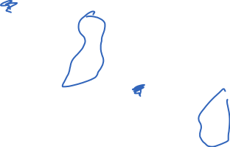
Building PRFs with hash functions: HMAC
K + ipad
M1
M2
f
f
f
IV1
K + opad
K1’
f
f
IV2
Y
K2’
Analysis approach:
Use related-key-attack (RKA) security of f(IV,K) to argue K1’, K2’ indistinguishable from random bit strings
Prove underlying NMAC construction a PRF assuming f(K,X) is good PRF
Inner iteration is computationally almost-universal (no collisions)
Composition of universal and PRF is PRF

Slide 8
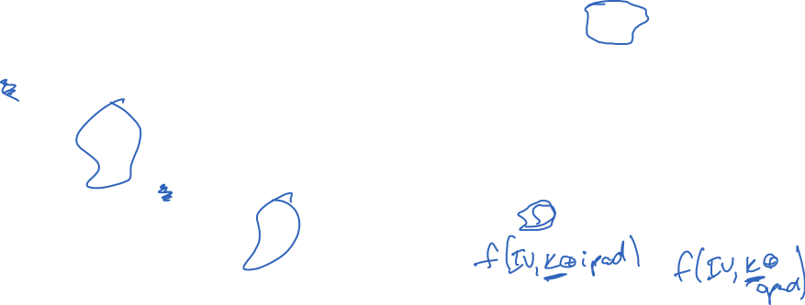
Related-key attacks
K + ipad
f
IV1
K + opad
K1’
f
IV2
K2’
Can we use regular PRF security to argue about outputs K1’ , K2’?

Slide 9

Related-key attacks
K + ipad
f
IV1
K + opad
K1’
f
IV2
K2’
RKA security is parameterized by set of related-key functions $Φ$
Security not achievable for some functions. E.g., constant function
For HMAC just need $Φ=\{φin$ $,φout$} where

Slide 10

Building PRFs with hash functions: HMAC
K + ipad
M1
M2
f
f
f
IV1
K + opad
K1’
f
f
IV2
Y
K2’
Analysis approach:
Use related-key-attack (RKA) security of f(IV,K) to argue K1’, K2’ indistinguishable from random bit strings
Prove underlying NMAC construction a PRF assuming f(k,X) is good PRF
Inner iteration is computationally almost-universal (no collisions)
Composition of universal and PRF is PRF

Slide 11
Two ways to fix
Figure out other constructions for hash-based PRFs using current hash functions
But: extension (or other) attacks that abuse MD-structure may arise elsewhere
Can we build hash functions that better emulate a RO?

Slide 12


Indifferentiability for hash transform design
M1
M2
M3||10^{r} || <|M|>
$$≈$$
RO
f
f
f
IV
Y
Want framework to build hash functions that “behave like” random oracles
[Coron et al. 2005] suggest using indifferentiability framework of
[Maurer, Renner, Holenstein 04] applied to hash functions,
Modeling f as itself a “small” fixed-input-length random oracle

Slide 13

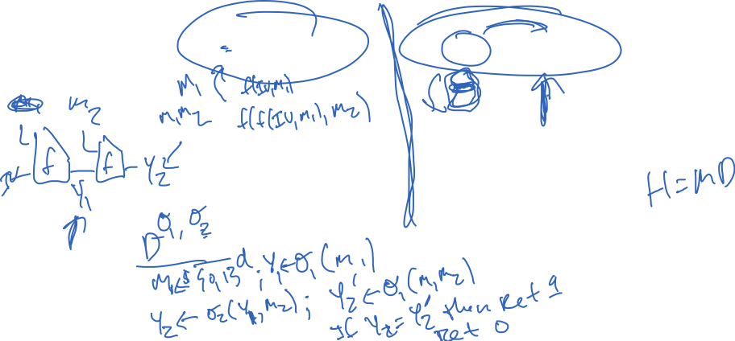









[CDMP05]: what property of a hash function H^{f} suffices
to avoid such structure-abusing attacks?
Indifferentiability from a RO
H^{f}
Real
H
f
RO
Sim
Ideal
D
D
0/1
0/1

Slide 14
[CDMP05]: what property of a hash function H^{f} suffices
to avoid such structure-abusing attacks?
Indifferentiability from a RO

Slide 15
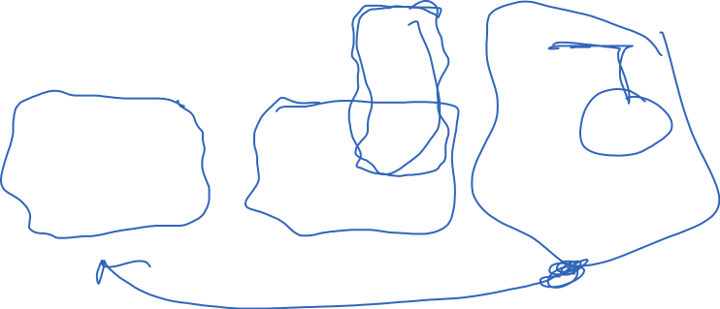

The “magic” is in [MRH04] composition theorem
For any security game G, construction H^{f}, and scheme C, if
(1) H^{f} indifferentiable from RO (f = RO) , and
(2) C provably G-secure in ROM
then C provably G-secure using H^{f} (f = RO)
B
H^{f}
RO
Sim
H
f
RO
D
C
A
C
A
C
B
G
G
G
0/1
0/1
0/1

Slide 16
Indifferentiability
from a RO
≈
“as secure
as a RO”
Indifferentiability has become a core requirement
for hash function design
Seems to rule out all structural attacks
Dozens of indifferentiable hash constructions in literature
SHA-3 hash contestants targeted it
Need to carefully interpret composition theorem (doesn’t apply to all security games)
see [Ristenpart, Shacham, Shrimpton 2011]

Slide 17
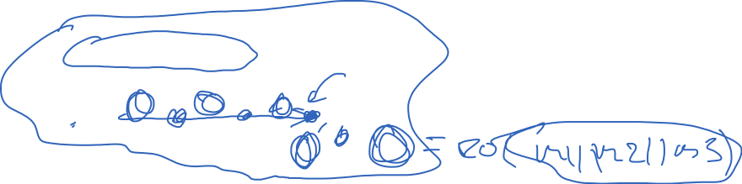
MD is not indifferentiable from a RO. What is?
M1
M2
M3||10^{r} || <|M|>
drops s < n bits
f
f
f
IV
C
Chopped Merkle-Damgard
M1
M2
M3||10^{r} || <|M|>
f
f
f
Enveloped Merkle-Damgard
IV1
f
IV2

Slide 18
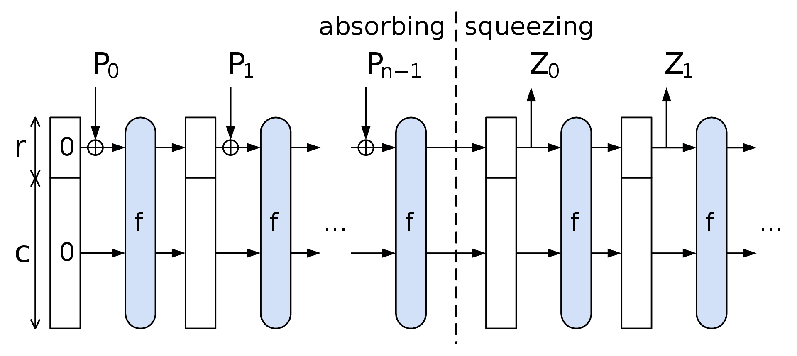
MD is not indifferentiable from a RO. What is?

Slide 19
Ideal cipher model and ROM equivalency
[CDMP05] showed how one can build indifferentiable from RO construction using an ideal cipher. MD-like transforms above combined with Davies-Meyer compression function
Longstanding open question was inverse: how to build something indifferentiable from ideal cipher from a RO
[Holenstein, Kunzler, Tessaro 2011] showed it
Feistel-like construction, but concrete security is poor
We often use ROM or ICM analyses. Used carefully, they provide great way of showing practical schemes secure

Slide 20
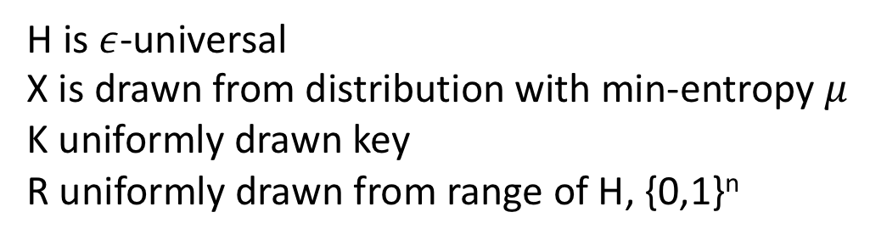
Other results about hash functions
Leftover hash lemma
Statistically secure key derivation
Fragile if assumptions don’t hold (X independent of K, sufficient min-entropy in X)
H is $ε$-universal
X is drawn from distribution with min-entropy $μ$
K uniformly drawn key
R uniformly drawn from range of H, {0,1}^{n}

Slide 21
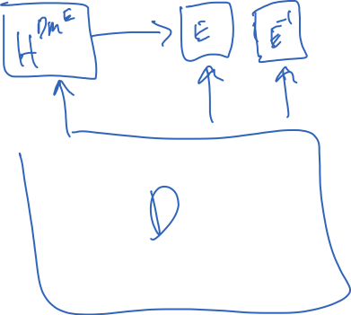

Slide 22
Applications of cryptographic hashing
File comparison
Digital signatures (coming up later)
For message authentication codes
Key derivation
Password hashing

Slide 23
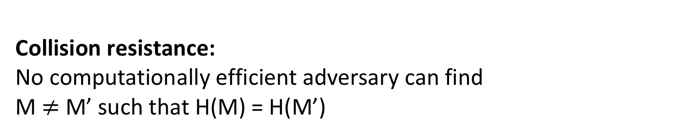
Cryptographic hash functions
MD5: n = 128 bits
SHA-1: n = 160 bits
SHA-256: n = 256 bits
SHA-512: n = 512 bits
SHA-3: n = 224, 256, 384, 512 bits
M
H
H(M)
Collision resistance:
No computationally efficient adversary can find
M $≠$ M’ such that H(M) = H(M’)

Slide 24
Collisions always exist
Domain (usually all strings up to some length)
SHA-256: up to length 2⁶⁴-1
Range {0,1}^{n}
H(M)
M
There exists CR adversary that wins with probability 1 and is efficient
H(M’)
M’
“Human ignorance”:
We can’t figure out what such an adversary is.
Good enough as an assumption
See [Rogaway 06]
M’’
H(M’’)
Not drawn to scale!!!
Pigeonhole principle:
size of domain larger than size of range implies there must be collisions

Slide 25
Birthday attacks
What is best possible security achievable by hash function with output length n bits?
Answer: security is only achievable up to 2^{n/2} hash computations

Slide 26
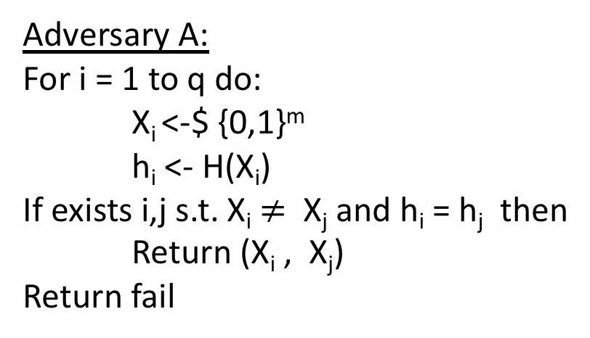
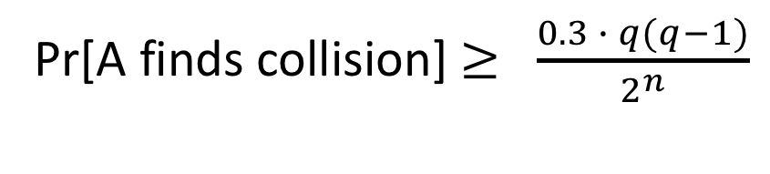
The birthday attack
Let m be some length in domain of hash function H
Adversary A:
For i = 1 to q do:
X_{i} <-$ {0,1}^{m}
h_{i} <- H(X_{i})
If exists i,j s.t. X_{i} $≠$ X_{j} and h_{i} = h_{j} then
Return (X_{i} , X_{j})
Return fail
Same # of domain points
map to each range point
If H is regular then probability of success is exactly birthday probability
Pr[A finds collision] $≥$ $\frac{0.3 ∙ q(q−1)}{2^{n}}$

Slide 27

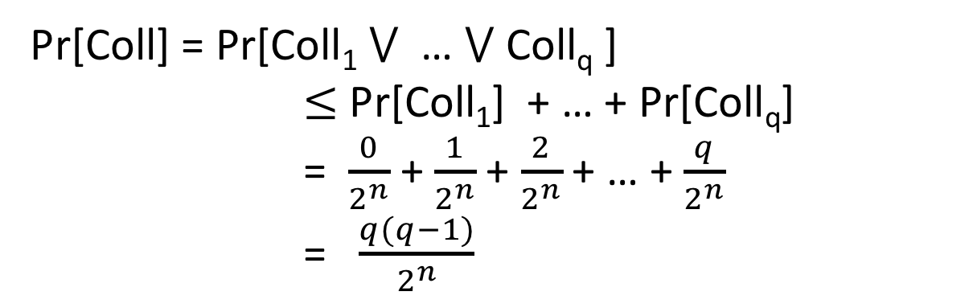
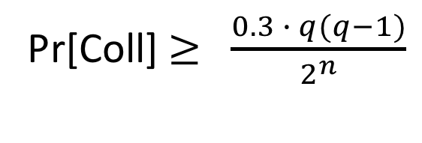
The birthday problem
Choose q values Y₁,…,Y_{q} from {0,1}^{n} at random. What is probability that two are the same?
Let Coll_{i} be event that Y_{i} = Y_{j} for some j < i
Pr[Coll] = Pr[Coll₁ $⋁$ … $⋁$ Coll_{q} ]
$≤$ Pr[Coll₁] + … + Pr[Coll_{q}]
= $\frac{0}{2^{n}}$ + $\frac{1}{2^{n}}$ + $\frac{2}{2^{n}}$ + … + $\frac{q}{2^{n}}$
= $\frac{q(q−1)}{2^{n}}$
Another proof shows that if q $≤$ 2^{(n+1)/2}
Pr[Coll] $≥$ $\frac{0.3 ∙ q(q−1)}{2^{n}}$

Slide 28
Birthday attack run times
MD5: n = 128 bits
SHA-1: n = 160 bits
SHA-256: n = 256 bits
2⁶⁴ MD5 computations
2⁸⁰ SHA-1 computations
2¹²⁸ SHA-2 computations
2⁶⁴ too small by today’s standards!
Bitcoin network computes about 2⁶⁵ SHA-256 hashes per second
https://blockchain.info/charts/hash-rate

Slide 29
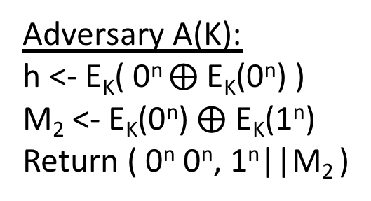
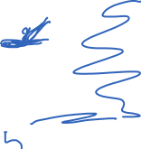
CBC-MAC is not CR
M₁
M₂
M₃
Key was secret in CBC-MAC.
But hash functions are publicly computable.
One idea is to use a random, public K value known to attacker.
E_{K}
E_{K}
E_{K}
h
How do we efficiently find collisions?
Adversary A(K):
h <- E_{K}( 0^{n} $⨁$E_{K}(0^{n}) )
M₂ <- E_{K}(0^{n}) $⨁$ E_{K}(1^{n})
Return ( 0^{n} 0^{n}, 1^{n}||M₂ )
Universal hashes are also not CR

Slide 30
Two-step MD design paradigm for hash functions
Compression
Function
Hash Function
d
*
n
Domain
extension
transform
n
f
n
H
Example: domain extension using “Merkle-Damgard with strengthening”
M1
M2
M3||10^{r} || <|M|>
Used in
MD-x, SHA-1,
SHA-256, …
f
f
f
IV
H(M)
r is minimal number of zeros needed to get to multiple of block size
IV is a fixed constant. Not randomly chosen.

Slide 31
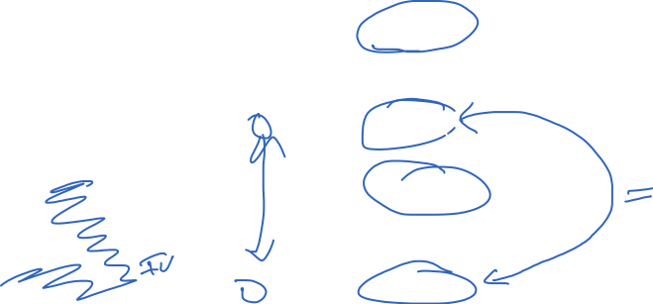
Merkle-Damgard CR preservation result
M1
M2
M3||10^{r} || <|M|>
f
f
f
IV
H(M)
M1’
M2’
M3’||10^{r} || <|M’|>
f
f
f
IV
H(M’)

Slide 32
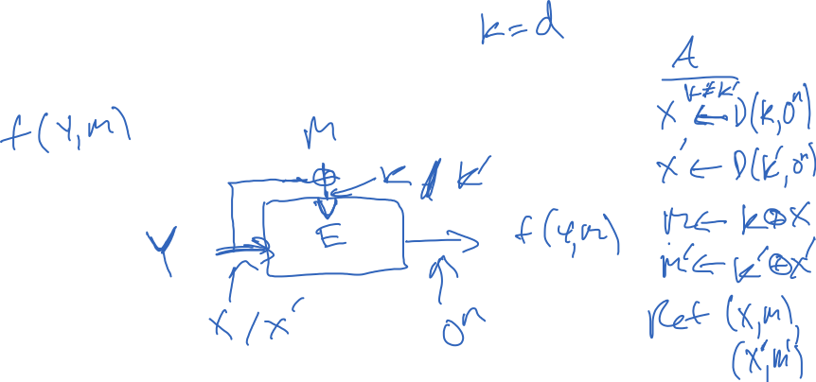
Building compression functions
Want:
Given:
Notes:
Examples of broken uses of block cipher. Simple m + z. E(m,z) or E(z,m).

Slide 33
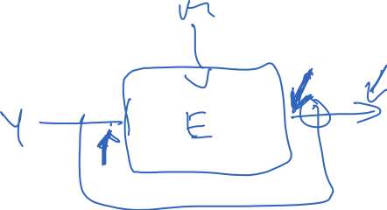
Building compression functions
Want:
Given:

Slide 34
Ideal cipher model
Want:
Given:
Model block cipher as ideal:
Each key selects independent random permutation
BC(k,n) = set of all block ciphers with k bit keys and n bit blocks
All algorithms given oracle access to ideal cipher
Notes:
Examples of broken uses of block cipher. Simple m + z. E(m,z) or E(z,m).

Slide 35
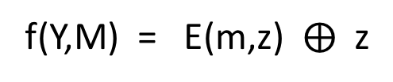

Davies-Meyers compression function
M
64 other “PGV” compression functions
12 have security profile similar to DM
See [Shrimpton, Rogaway 2002]
f(Y,M) = E(m,z) $⨁$ z
Z
E
Notes:
Examples of broken uses of block cipher. Simple m + z. E(m,z) or E(z,m).

Slide 36

From [Rogaway, Shrimpton 2002]

Slide 37
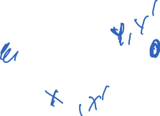
Davies-Meyers compression function
M
64 other “PGV” compression functions
12 have security profile similar to DM
See [Shrimpton, Rogaway 2002]
f(Y,M) = E(m,z) $⨁$ z
Z
E
Notes:
Examples of broken uses of block cipher. Simple m + z. E(m,z) or E(z,m).

Slide 38
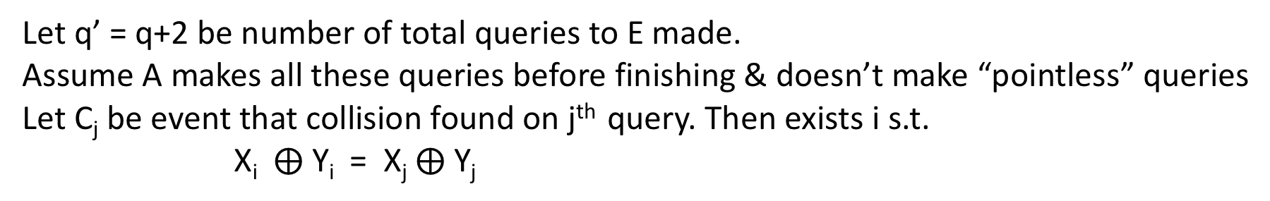
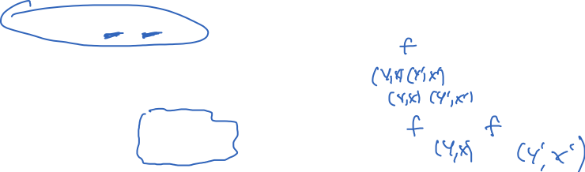
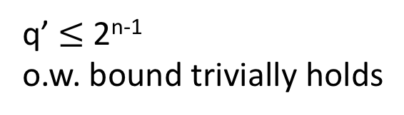
Let q’ = q+2 be number of total queries to E made.
Assume A makes all these queries before finishing & doesn’t make “pointless” queries
Let C_{j} be event that collision found on j^{th} query. Then exists i s.t.
X_{i} $⨁$ Y_{i} = X_{j} $⨁$ Y_{j}
q’ $≤$ 2^{n-1}
o.w. bound trivially holds

Slide 39
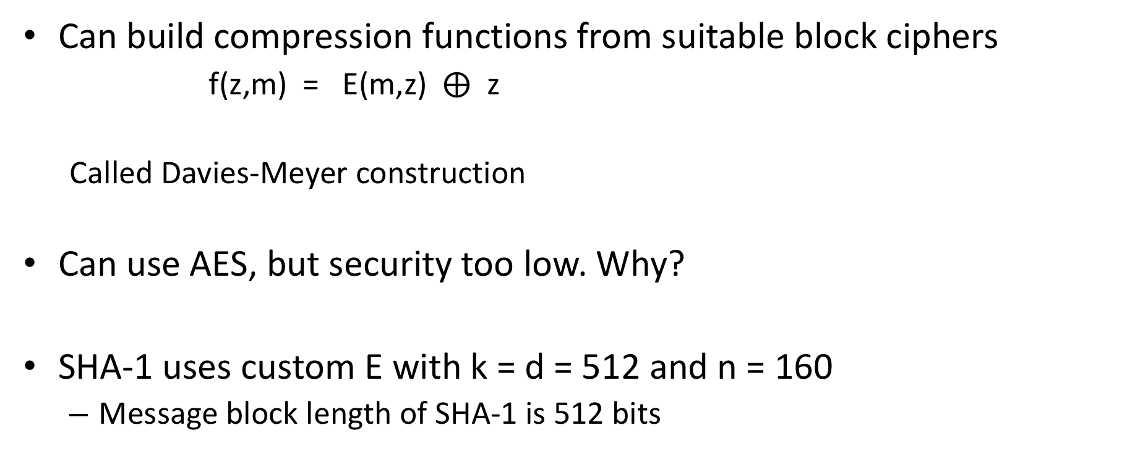
Building compression functions
Can build compression functions from suitable block ciphers
f(z,m) = E(m,z) $⨁$ z
Called Davies-Meyer construction
Can use AES, but security too low. Why?
SHA-1 uses custom E with k = d = 512 and n = 160
Message block length of SHA-1 is 512 bits
Notes:
Examples of broken uses of block cipher. Simple m + z. E(m,z) or E(z,m).

Slide 40
SHA-1 compression function
Expand 512-bit message into
W₁,…,W₈₀ strings of length 32 bit values
(Think of this as “key schedule”)
Chaining variable is 160 bits, 5 32-bit values
A , B , C , D , E
F(B,C,D) function that changes over rounds:
0-19: (B and C) or ((not B) and D)
20-39: B xor C xor D
40-59: (B and C) or (B and C) or (C and D)
60-79: B xor C xor D
Constants K₁ , … , K₈₀ differ across rounds

Slide 41
Cryptanalysis results
2004: Full break of MD5 announced by Xiaoyun Wang and co-authors
MD5 is easy to break now. You can download programs to do it on your laptop
2005: Announced faster than 2⁸⁰ attack against SHA-1 by Wang et al.
Not practical to run (2⁶⁹ estimated cost)
2017: CWI and Google announce first demonstrated collision

Slide 42

SHAttered attack
Chosen prefix P. Find two pairs of message blocks
M₁ , M₂ and M₁’ , M₂’ such that for any suffix S:
SHA-1(P || M₁ || M₂ || S) = SHA-1(P || M₁’ || M₂’ || S)
Referred to as a identical-prefix collision attack
How? Pick P, find M₁ and M₁’ that form near-collision on chaining variable. Then complete collision by finding M₂ and M₂’
They show how to extend to build colliding PDF files

Slide 43
SHAttered attack
Required 2^{63.1} SHA-1 compression function applications
100,000x faster than birthday attack (2⁸⁰)

Slide 44
Fallout of attack
SVN repositories can be broken (DoS attack)
- Checking in the two SHAttered PDFs corrupts repo
Linus Torvalds misunderstands security…
(to paraphrase) GIT’s ok because we can trust everyone
https://plus.google.com/+LinusTorvalds/posts/7tp2gYWQugL
Marc Stevens & Dan Shumow (Microsoft) developed counter-cryptanalysis tool
Way to detect if a particular file is one half of colliding pair
Deployed at several large companies
Ongoing migration away from SHA-1 to SHA-256 / SHA-3

Slide 45
SHA-3 competition
SHA-1 attacks prompted NIST competition for new hash function 2007-2012
51 submissions; 14 proceeded to round 2; 5 finalists
KECCAK selected as winner
Bertoni, Daemon, Peeters, Van Assche

Slide 46

Sponge construction

Slide 47
Towards using hash functions as PRFs
Hash functions don’t have keys. So we must key them somehow to treat as PRFs.
K || M
H
This is vulnerable to length extension attacks

